Slide 1

By: Denishia Linton

Slide 2
OVERVIEW
Visual Plan
Legend Key
Store Lightings
Music
Wall Visual Plan
Wall Visual

Slide 3
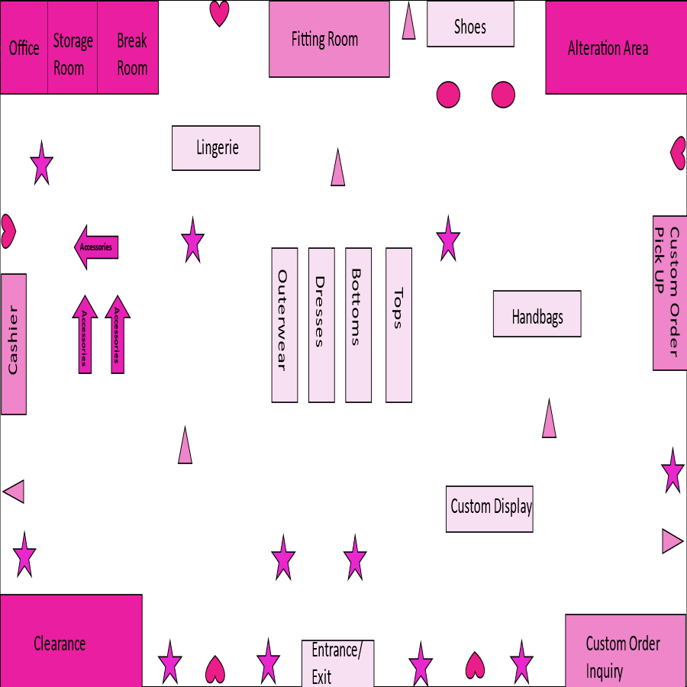
VISUAL PLAN: STORE FRONT LAYOUT
COLOR SCHEME OF THE STORE
BARBIE UNIVERSE

Slide 4

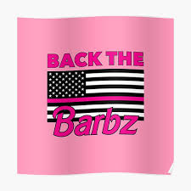
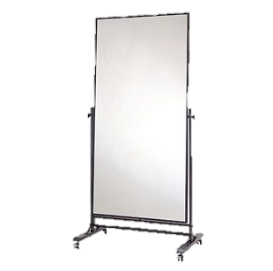
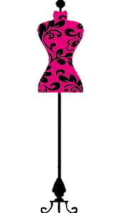
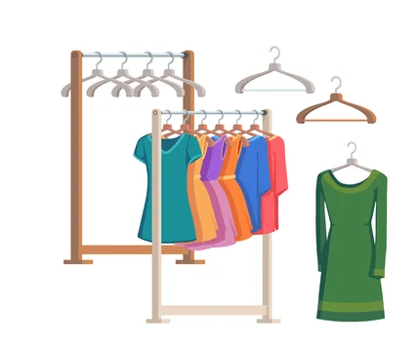
LEGEND KEY
Posters =
Chairs =
Mirrors =
Accessories =
Mannequin =
Clothing Racks =

Slide 5
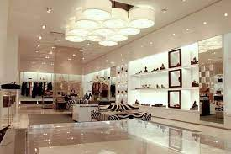
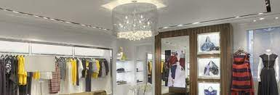
STORE LIGHTINGS

Slide 6
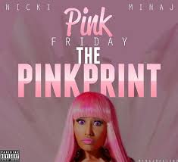
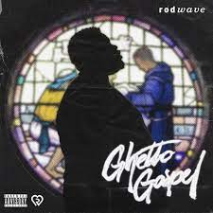
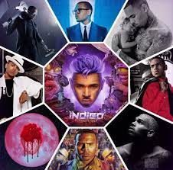
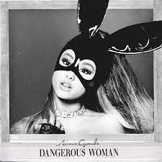
MUSIC
HIP HOP/ RNB, and POP

Slide 7
WALL VISUAL PLAN
Everything will be basically different shades of pink and also splashes of glitter. I will also have different tones of grey and a green flower plant wall.
Mirrors
Posters
Displays
Folded clothing such as (Lingerie, Pants, and Tops)
Accessories
Mannequins

Slide 8
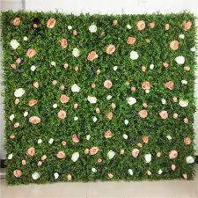
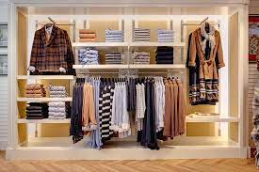
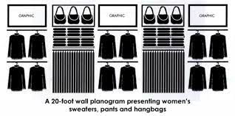
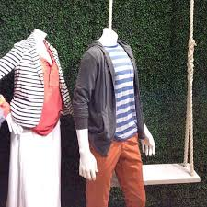
WALL VISUAL

