Slide 1

Project 1
By: Denishia Linton

Slide 2
OVERVIEW
COMPETITIVE ANALYSIS
CUSTOMER PROFILE
MISSION & VISION
MERCHANDISE ASSORTMENT ANALYSIS
MERCHANDISE ASSORTMENT PROPOSALS
VISION PLAN

Slide 3
COMPETITIVE ANALYSIS
 | FOREVER 21 | DISCOVERY | WINDSOR
PROS | Provides clothing for men, women, and kids. | Affordable prices | A great formal women’s collection.
CONS | Most kids' clothes aren’t shown in stores. | The store doesn’t have a dressing room in store. | The store doesn’t advertise as much as others.
Akira can gain from these retailers by adding more options to their collection and making sure they not only stay on top of the latest trends and but also start their own trends. Akira can also try offering more affordable prices.

Slide 4
CUSTOMER PROFILE
DEMOGRAPHICS
PSYCHOGRAPHICS
AGES: 18 and older
GENDER: Female
INCOME: Middle class
EDUCATION: Any level
OCCUPATION: Fashion, Instagram model, club promoter, and influencers.
PERSONALITIES: Outgoing, creative, sexy, and classy.
LIFESTYLES: Models, promoter, business owner, and college students.
INTERESTS: Influencers, social media, business, clubbing, and partying.

Slide 5
MISSION & VISION
AKIRA MISSION: AKIRA is determined to change this mindset with original thinking and an emphasis on strong designers and curated styles. We are working hard to heighten awareness across the country and put Chicago on the Fashion Map.
AKIRA VISION: It's all about people. And when it comes down to it, business is simply “People selling things to other people”. So, we want to make sure that our people are the right ones. And so far, they are. With a very rigorous selection process, AKIRA is fanatical about ensuring that customers are styled by experts who eat, sleep, and breathe fashion. We live to make AKIRA customers look good and feel good.

Slide 6

MERCHANDISE ASSORTMENT ANALYSIS
What merchandise should remain and why?
Akira should continue to offer trendy women clothing because those items are the most popular. Akira should also continue to dress up their mannequins to give consumers outfit ideas.
Which merchandise should be eliminated and why?
I honestly feel that everything that Akira offers should stay. The store doesn’t have any flaws besides the pricing.
What new merchandise should be carried and why?
- Akira should offer lingerie and sleepwear because it would be a one stop shop for women.

Slide 7
MERCHANDISE ASSORTMENT PROPOSALS
DEPARTMENT NAME: “SUDUCTIVE”
ITEMS: Lingerie, underwear, bras, and socks
COLORS: Black, red, white, orange, pink, yellow, blue, nude, purple and rainbow.
SIZES: XXS-5XL
DEPARTMENT NAME: “CUDDLES”
ITEMS: Pajamas, and robes
COLORS: Black, red, white, orange, pink, yellow, blue, nude, purple and rainbow.
SIZES: XXS-5XL

Slide 8
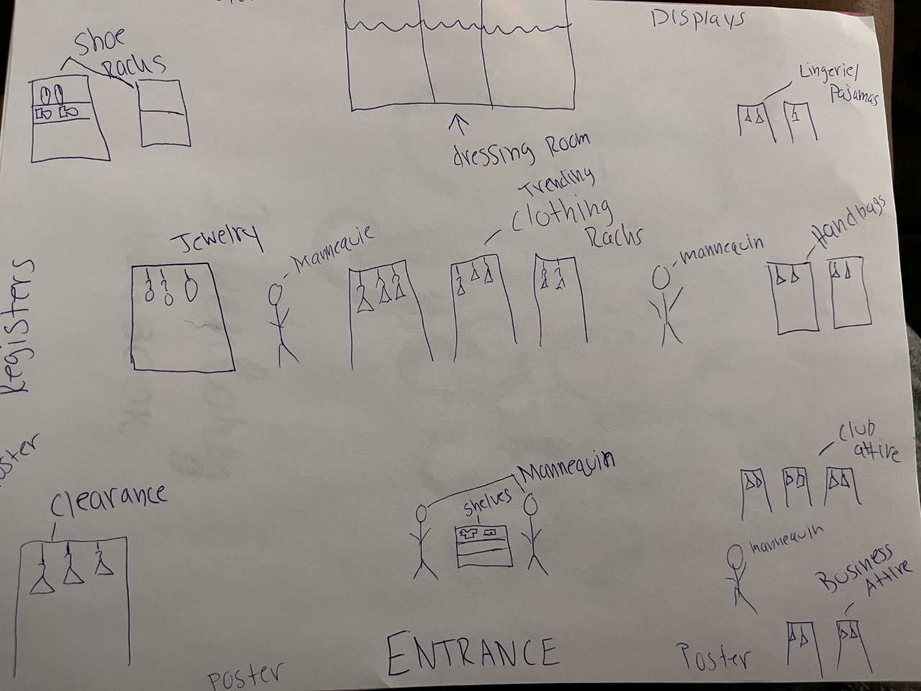
VISUAL PLAN

